Slide 1


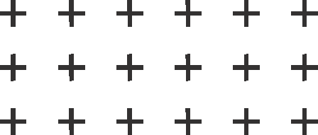

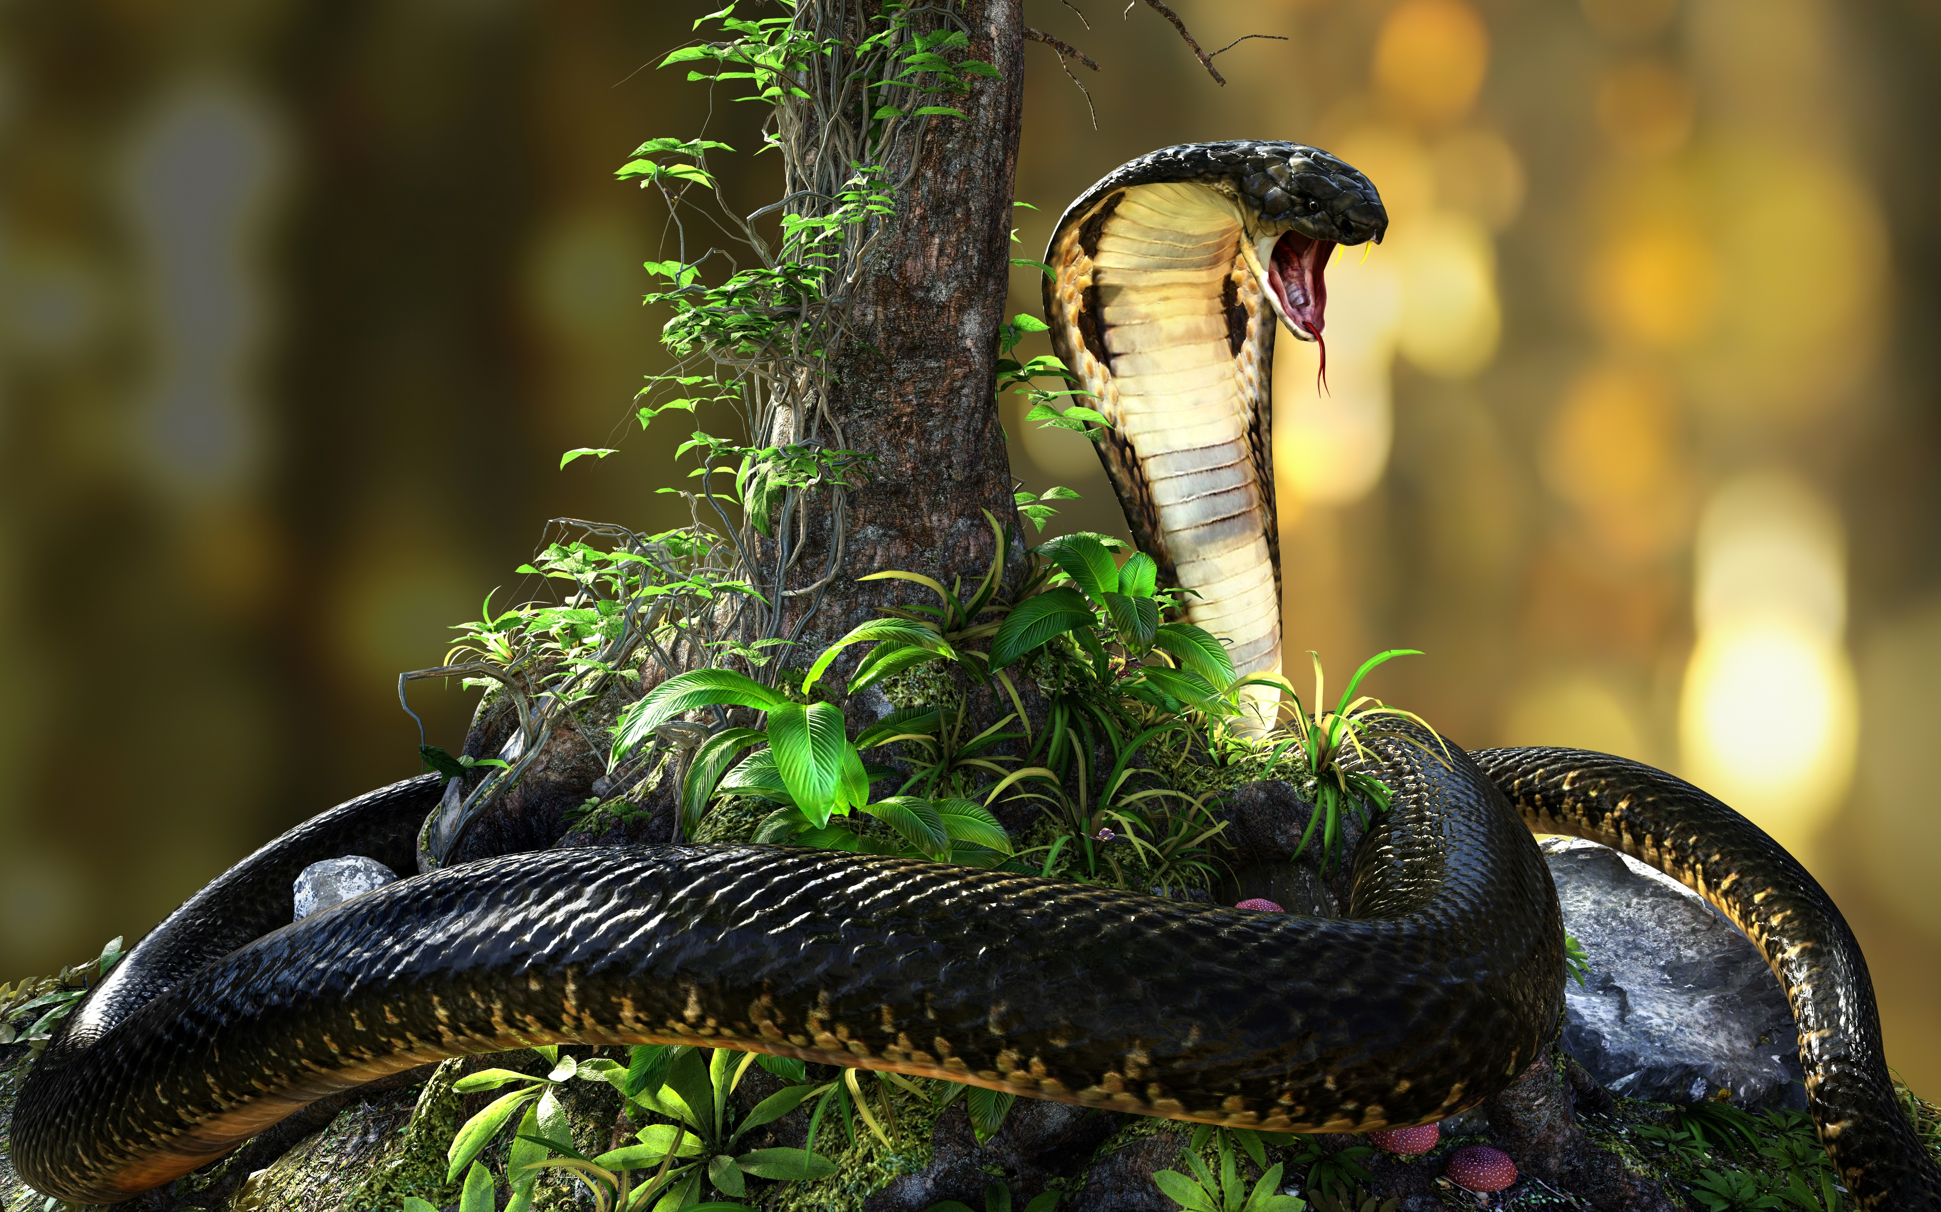






SNAKE GAME

Slide 2
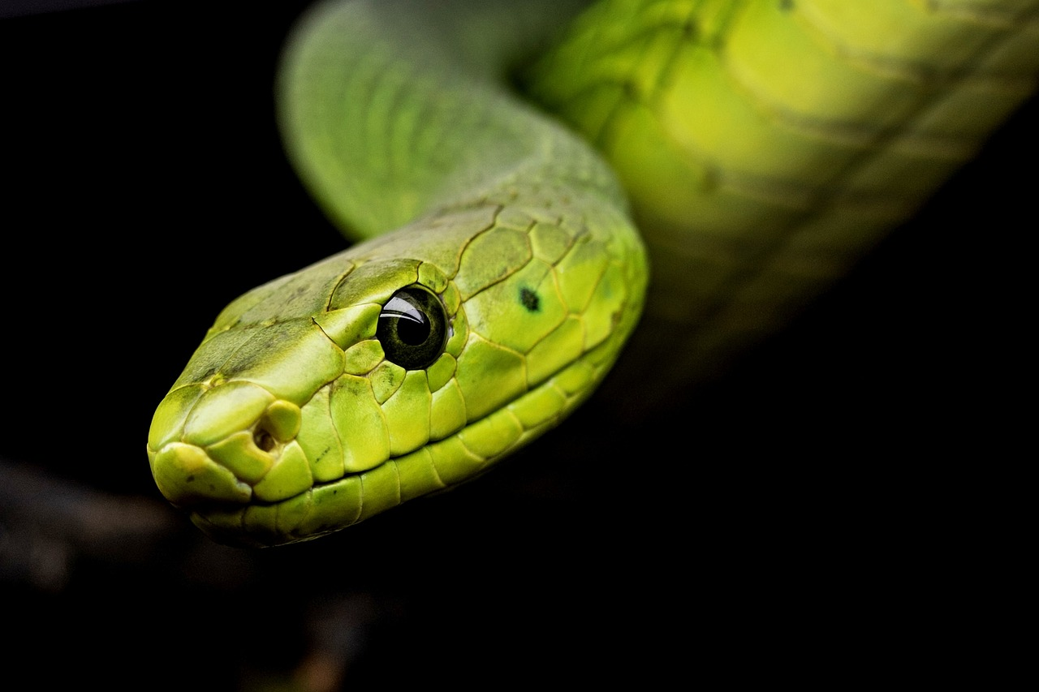
Screen and Dimensions:
The game screen has dimensions of 800x600 pixels.Each part of the snake and the bait is 20x20 pixels in size.

Slide 3
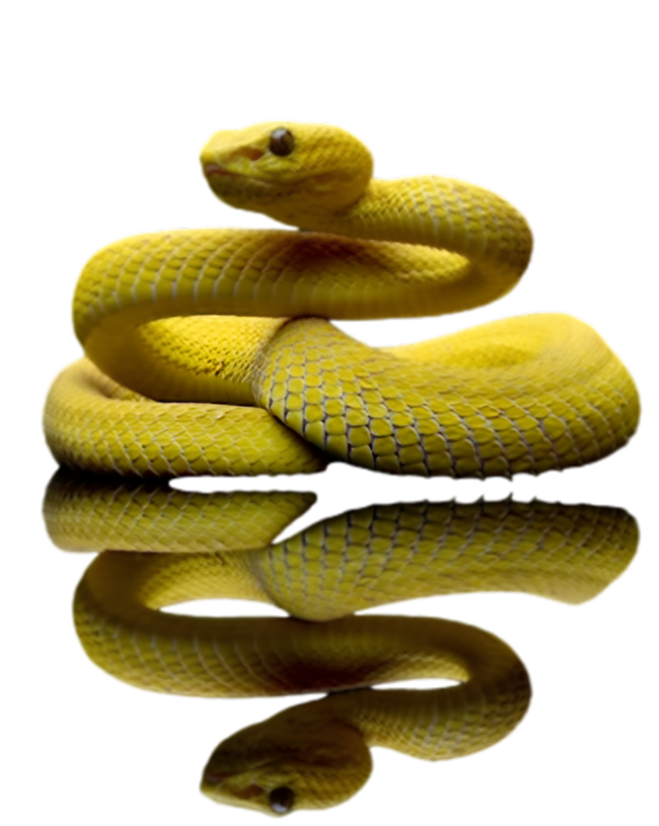
Colors and Directions
The player snake is green, the AI ​​snake is orange, and the bait is red.Snakes can move in four directions (up, down, left, right).

Slide 4
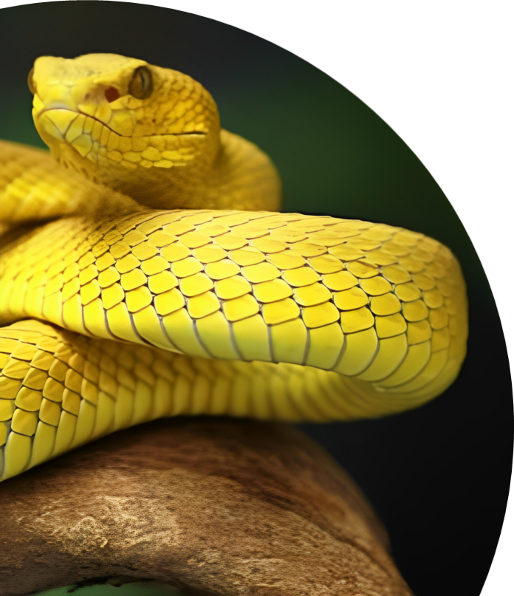
Snake
Snakes consist of one part at the beginning.They change direction and move, and if they leave the screen, they return from the other side.They grow when they eat food.

Slide 5
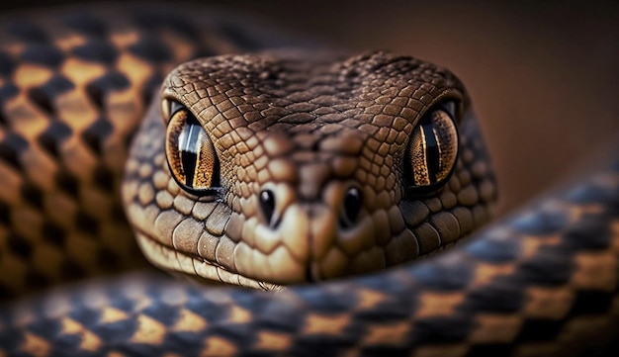
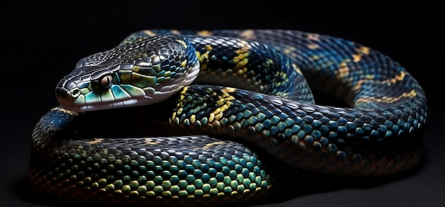
Bait
Baits are positioned randomly.Once the snakes eat the bait, the bait is placed in another random location.

Slide 6
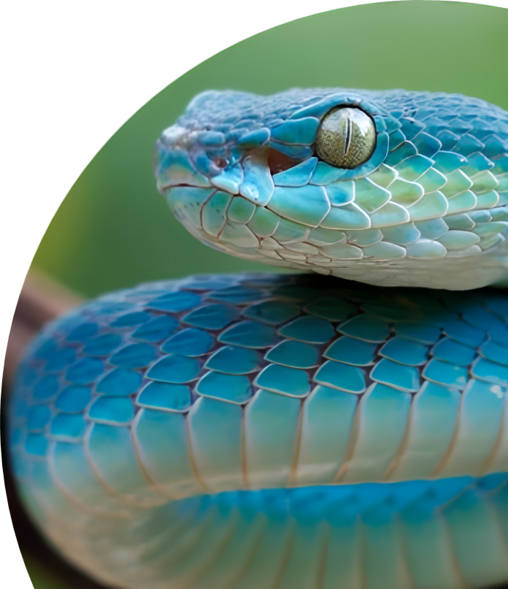
Collisions
The game ends when the snakes hit each other. Snakes can hit their own bodies.

Slide 7
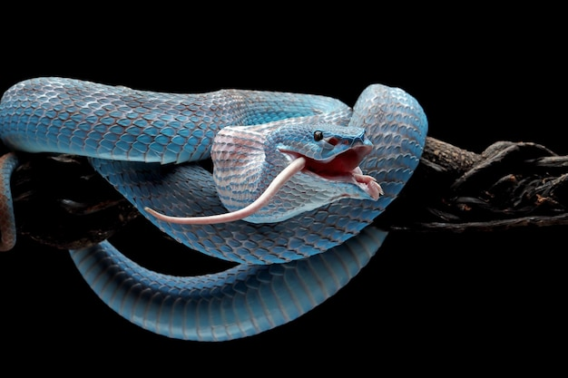
Artificial intelligence
Artificial intelligence snake finds the shortest path to food using the BFS (Breadth First Search) algorithm.Depending on the error rate, it may sometimes move in a random direction.

Slide 8
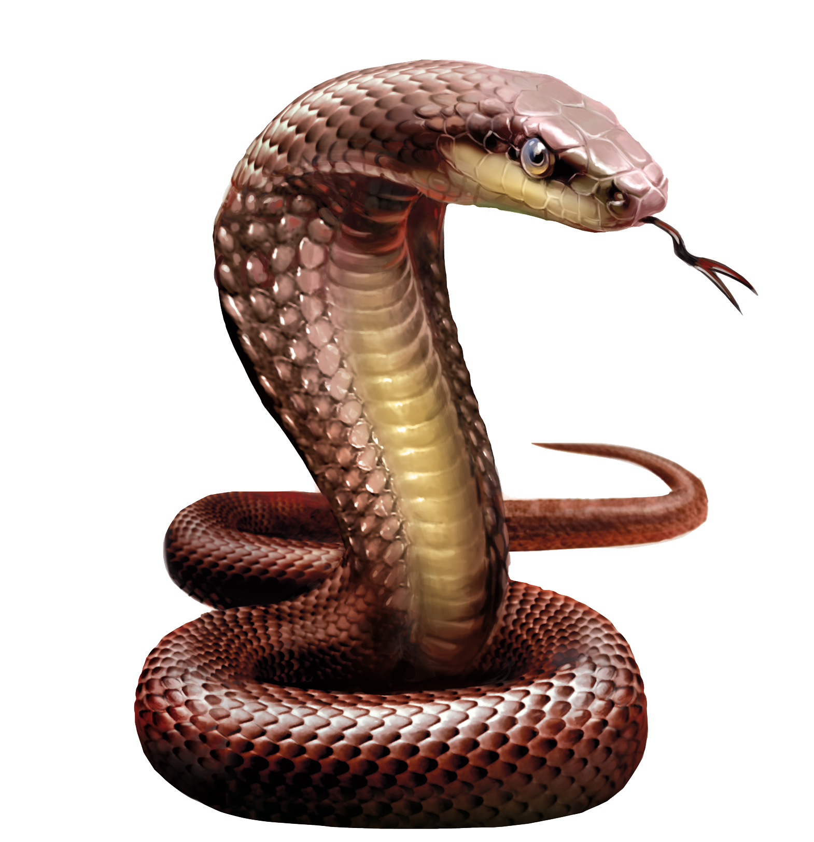
Scores
The number of feeds eaten by the player and the artificial intelligence snakes is kept as a score and displayed on the screen.

Slide 9
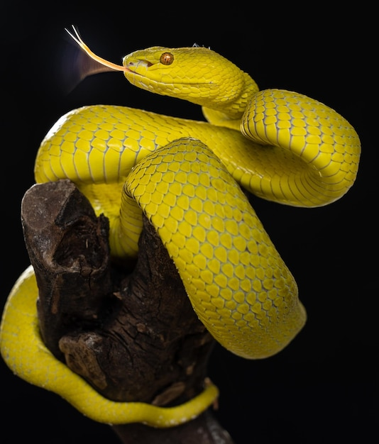
Conclusion
In conclusion, this snake game reimagines the classic snake game with a modern approach, providing the opportunity to compete against both the player and the artificial intelligence. This game successfully combines user interactions and artificial intelligence algorithms, providing a fun and challenging gaming experience . The game's loop constantly controls on-screen movements and collisions, providing a dynamic and continuous gameplay environment.

Slide 10
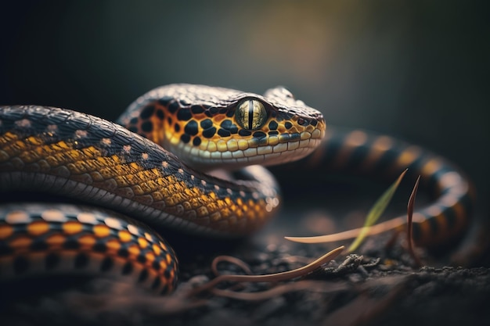
Thanks for listening

